Slide 1


DHANALAKSHMI SRINIVASAN ENGINEERING COLLEGE (AUTONOMOUS) PERAMBALUR - 621212
BATCH : 5
ETHEREUM-BASED KYC FRAMEWORK FOR IMPROVED CUSTOMER VERIFICATION IN BANKING
PRESENTED BY:
RIYAZ AHAMED J (810421104141)
SIVASAKTHI S (810421104165)
THANIGASALAM V (810421104177)
YUVARAJ K (810421104192)
GUIDED BY:
Mrs. S. FRANCIS SHAMILI M.E., ASSISTANT PROFESSOR - CSE

Slide 2
TABLE OF CONTENTS
01
O B J V E C T I V E.
07
S Y S T E M R E Q U I R E M E N T
02
A B S T R A C T
08
M O D U L E S
03
E X I S T I N G S Y S T E M
09
C O N C L U S I O N
04
L I T E R A T U R E S U R V E Y
10
F U T U R E
E N H A N C E M E N T S
05
P R O P O S E D S Y S T E M
11
O U T P U T
06
A R C H I T E C T U R E
12
R E F E R E N C E S

Slide 3
OBJECTIVE
The objective of this project is to create a decentralized KYC verification system using a private Ethereum blockchain network for avoiding the money laundering, reduce the time for creating and managing the KYC Data by automating the process.

Slide 4
ABSTRACT
This project uses a private Ethereum blockchain to improve KYC processes for banks, ensuring secure, transparent, and tamper-proof identity verification. Smart contracts and role-based access control allow only authorized banks to manage sensitive data, reducing redundancy, fraud, and costs. The system speeds up onboarding, enhances compliance, and offers a streamlined, efficient experience for both banks and customers.

Slide 5
EXISTING SYSTEM
Decentralized KYC Management: Uses Ethereum blockchain to eliminate redundant processes, with a single verified KYC record accessible by authorized banks.
Centralized Oversight: A central bank manages the registry and ensures regulatory compliance.
Smart Contract Automation: Automates key tasks like bank registration, identity verification, and privilege management for secure, consistent operations.
Cost and Efficiency Gains: Reduces operational costs and simplifies data sharing by minimizing intermediaries.
Challenges: Faces smart contract vulnerabilities (e.g., overflow, re-entrancy) and depends on centralized oversight, highlighting areas for improvement.

Slide 6
DISADVANTAGES
Scalability
Centralized Control
Privacy Concerns
Regulatory Compliance

Slide 7
PROPOSED SYSTEM
Private Ethereum Network: Operates with PoA consensus, including admin, bank, and observer nodes.
Smart Contracts: Bank.sol and Admin.sol handle secure KYC registration and approval.
MetaMask Integration: Enables secure and seamless blockchain interactions.
Immutability and Transparency: Ensures reliable audit trails and data integrity.

Slide 8
ADVANTAGES
High Security
Data Integrity
Transparency
Efficiency
Privacy
Cost Savings

Slide 9
LITERATURE SURVEY
S.NO | TITTLE & AUTHORS | TECHNIQUES & METHODS | DRAWBACKS
1 | A SURVEY ON BLOCKCHAIN TECHNOLOGY: EVOLUTION, ARCHITECTURE AND SECURITY(M. N. M. Bhutta, A. A. Khwaja, A. Nadeem, H. F. Ahmad, M. K. Khan, M. A. Hanif, H. Song, M. Alshamari and Y. Cao,) | Distributed Ledger Technology (DLT), Smart Contracts, Cryptographic Hashing, Internet of Things (IoT) Integration, Tokenization and Supply Chain Tracking via Blockchain | Existing SCM systems may face difficulties in adopting blockchain without significant adjustments
2 | FORTIFYING THE BLOCKCHAIN: A SYSTEMATIC REVIEW AND CLASSIFICATION OF POST-QUANTUM CONSENSUS SOLUTIONS FOR ENHANCED SECURITY AND RESILIENCE(J. Gomes, S. Khan, and D. Svetinovic) | Post-Quantum Cryptography, Quantum-resistant Consensus Algorithms, Quantum Key Distribution (QKD), Hash-Based Signatures and Lattice-Based Cryptography. | Post-quantum cryptography is still in the research phase, and practical implementations are not yet widely available
3 | AN EXAMINATION OF DISTRIBUTED AND DECENTRALIZED SYSTEMS FOR TRUSTWORTHY CONTROL OF SUPPLY CHAINS(V. Kumar C and P. Selvaprabhu) | Consensus Algorithms, Cryptographic Primitives, Smart Contracts, Distributed Ledger Technology (DLT) and Public, Private, and Consortium Blockchains | Some consensus algorithms (like Proof of Work) require significant energy resources.
4 | DEMO: BLOCKCHAIN FOR THE SIMPLIFICATION AND AUTOMATION OF KYC RESULT SHARING(R. Norvill, M. Steichen, W. M. Shbair, and R. State) | Blockchain, Access Control, Private Blockchain, Off-chain Storage and GDPR Compliance. | Ongoing challenges with global data protection laws and cross-border data sharing.
5 | BLOCKCHAIN-BASED KYC MODEL FOR CREDIT ALLOCATION IN BANKING(B. Karadag, A. Halim Zaim, and A. Akbulut) | Blockchain Technology, Ethereum, Smart Contracts (Solidity) and Private Blockchain Network | The system may slow down as more banks and transactions are added, especially with high data volumes.

Slide 10
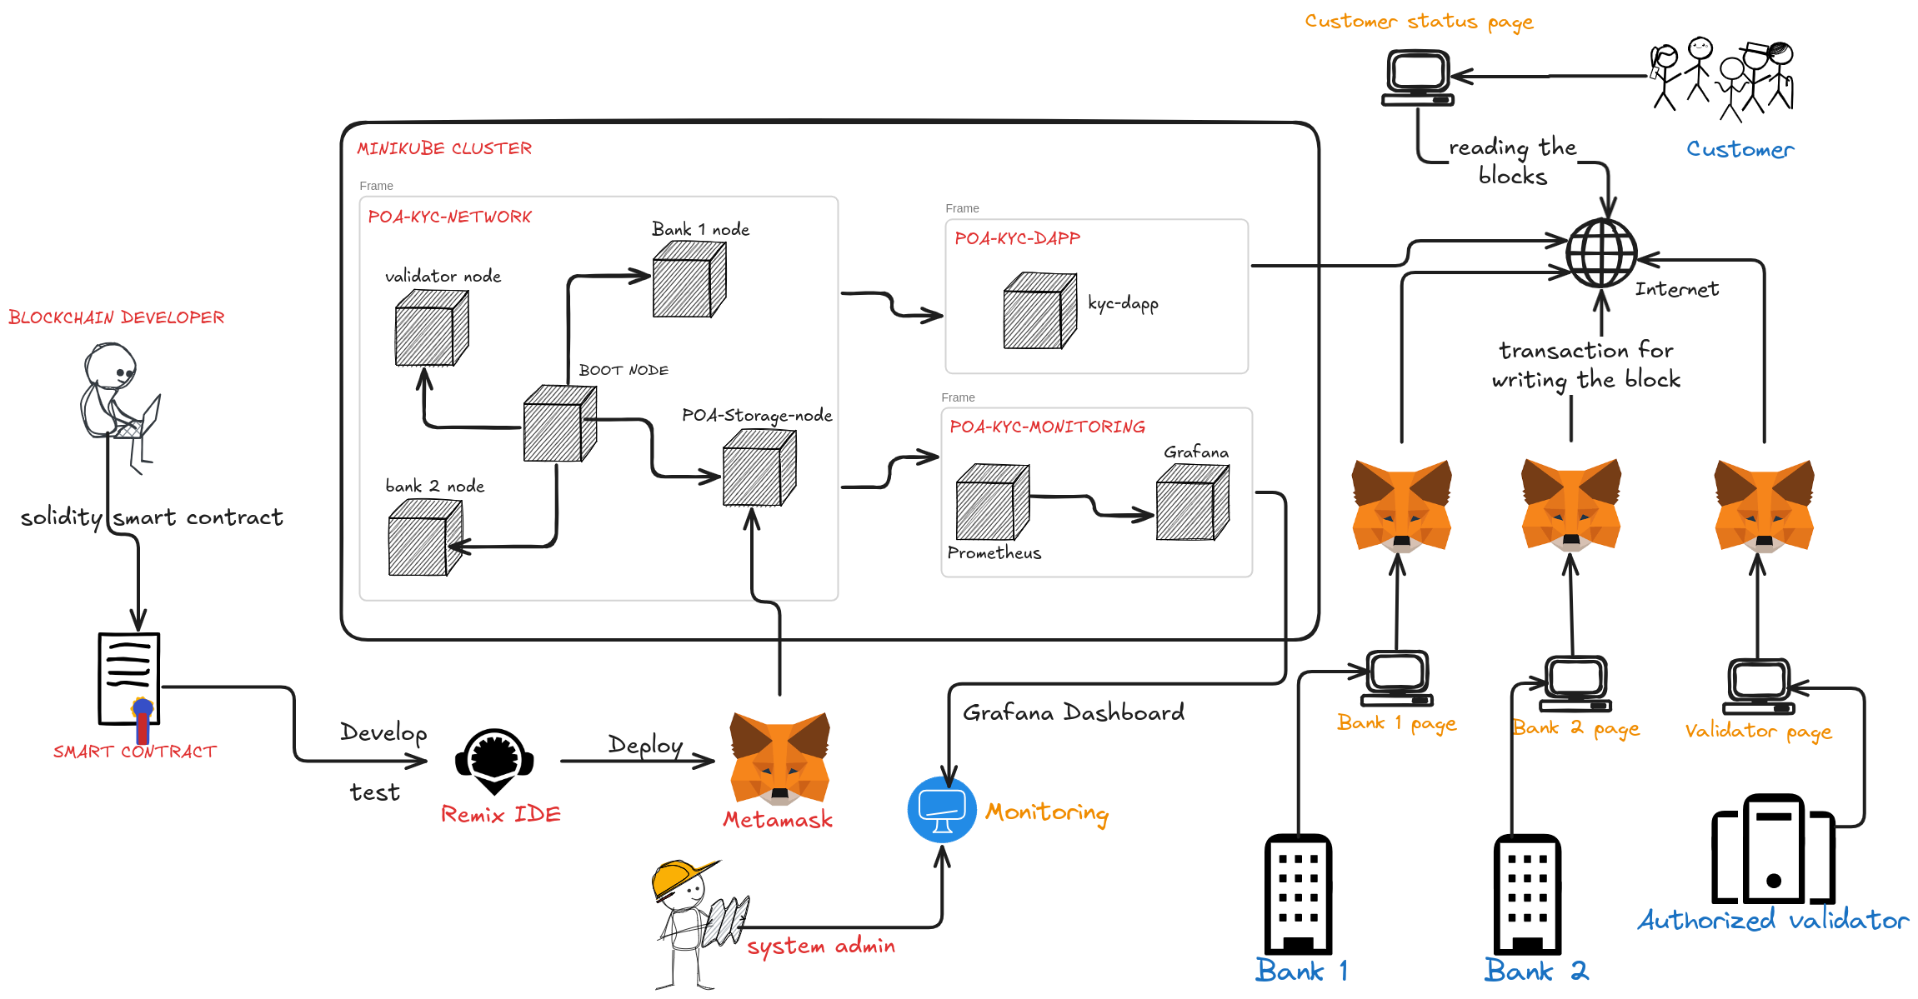
ARCHITECTURE

Slide 11
SYSTEM REQUIREMENT
HARDWARE
1. CPU:Multi-core CPU (4 cores)
2. RAM:Minimum 4GB (8GB)
3. Storage:SSD with at least 50GB of available space
4. Network:High-speed, stable internet connection
SOFTWARE
Operating System:Linux-based OS (Ubuntu)
2. Blockchain Client: Geth (Go-Ethereum),Remix IDE
Frontend Interaction: MetaMask, Ethers.js
Management and Deployment: Docker,Minikube
Monitoring Tools:Prometheus and Grafana
Browser: Chrome or Firefox

Slide 12
MODULES
Set Up Nodes for Private Blockchain
Develop Smart Contract
Implement, Test, and Deploy Smart Contract
Containerize the Blockchain Nodes
Handle Accounts and Transactions
Monitor Nodes and Network Performance
Coordinate Node Deployment and Scaling

Slide 13

SET UP NODES FOR PRIVATE BLOCKCHAIN
Setting up nodes is essential for building a private blockchain network. Each node plays a specific role, such as validating transactions, storing data, or connecting other nodes, ensuring secure and efficient operation within the network.
Tool Used: Geth (Go Ethereum)
Geth (Go Ethereum) is a tool used to create and manage Ethereum nodes. It supports account management, smart contract deployment, and network monitoring, making it ideal for building private and public Ethereum networks.

Slide 14
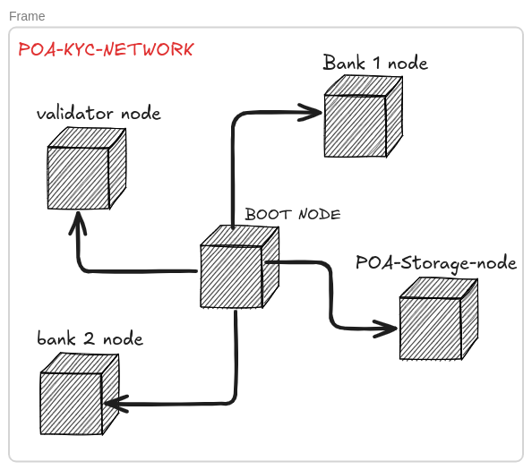
What We Did with Geth
Using Geth, we set up the following nodes:
Bootnode: Allows other nodes to connect and join the network.
Validator Node: Validates transactions and secures the blockchain.
Bank1 Node and Bank2 Node: Represent two banks that handle transactions and interact with smart contracts.
PoA Storage Node: Stores data under the Proof of Authority (PoA) consensus for fast, secure storage.
These nodes collectively ensure a secure, functional private blockchain network.

Slide 15

DEVELOP SMART CONTRACT
The smart contract is the core of our blockchain network, handling automated processes like approvals, rejections, KYC registration, and status updates. We used a Proof of Authority (PoA) approach to manage the contract functions securely and efficiently.
Tool Used: Solidity
Solidity is the programming language used to create smart contracts on Ethereum. It allows us to define custom functions and rules, ensuring the contract automatically enforces the specified logic on the blockchain.

Slide 16
What We Did with Solidity
Using Solidity, we developed and deployed several smart contracts for our PoA-based blockchain network:
PoA-Contract.sol: Manages network operations and permissions.
Validator.sol: Controls approval and rejection of actions by validator nodes.
Bank1.sol & Bank2.sol: Handle KYC registration and retrieval for each bank.
KYCList.sol: Tracks and displays KYC request statuses for monitoring.
These smart contracts ensure the network operates smoothly, with automated approvals, rejections, and secure KYC management.

Slide 17

IMPLEMENT, TEST, AND DEPLOY SMART CONTRACT
Testing and deployment are critical steps to ensure that smart contracts work as intended before going live on the blockchain network. This process involves checking each function and deploying the contracts to interact with other network components.
Tool Used: Remix IDE
Remix IDE is an online development environment for writing, testing, and deploying smart contracts on Ethereum. It provides a simple interface to compile and test contract functions, helping catch errors before deployment.

Slide 18
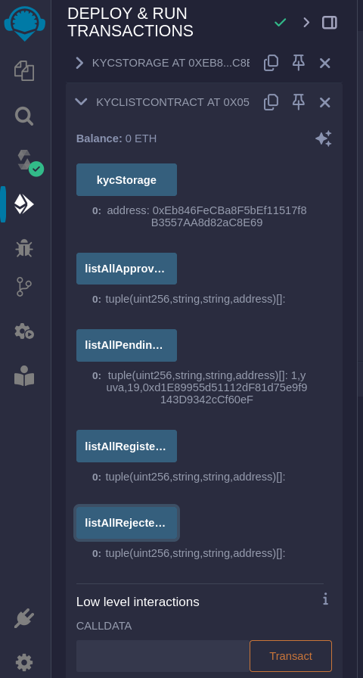
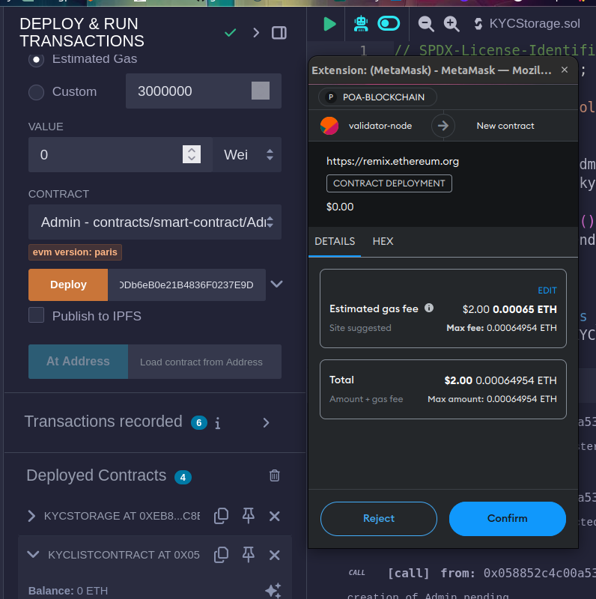
What We Did with Remix IDE
Using Remix, we:
Tested Functions: Verified each function, such as KYC registration, approval, and rejection, ensuring they perform as expected in different scenarios.
Deployed Contracts: Deployed the smart contracts to our private blockchain, making them accessible to the relevant nodes (validator, bank nodes).
This process ensured that our contracts are error-free and functional, ready to securely manage operations within the network.

Slide 19

CONTAINERIZE THE BLOCKCHAIN NODES
Containerization is the process of packaging software and its dependencies into a container to ensure it runs reliably in different computing environments. By containerizing the Ethereum nodes, we can easily deploy, manage, and scale the blockchain network.
Tool Used: Docker
Docker is a platform that enables developers to package applications and their dependencies into containers. It helps in creating isolated environments for each Ethereum node, ensuring consistency and portability across different systems.

Slide 20
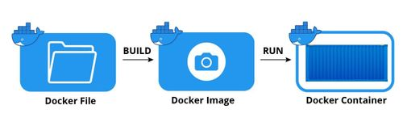
What We Did with Docker
Using Docker, we:
Containerized Nodes: Each Ethereum node (Bootnode, Validator, Bank1, Bank2, PoA Storage) is packaged into separate containers for easier deployment.
Automated Deployment: Docker automates node deployment, enabling quick setup and resets.
Isolated Environment: Each container runs independently, ensuring stable and conflict-free configurations.
Scalability & Portability: Containerization ensures a scalable, portable, and manageable blockchain network.
Containerizing the nodes helps ensure that our blockchain network is scalable, portable, and easy to manage.

Slide 21


HANDLE ACCOUNTS AND TRANSACTIONS
This section explains how accounts (such as the Admin and Bank accounts) and transactions are managed within your Ethereum-based KYC verification application.
TOOLS USED: METAMASK, ETHER.JS
MetaMask acts as a digital wallet to manage Ethereum accounts (Admin, Bank1, Bank2) and securely sign transactions.
Ether.js are JavaScript libraries that interact with the Ethereum blockchain to send and receive data, including transactions.

Slide 22
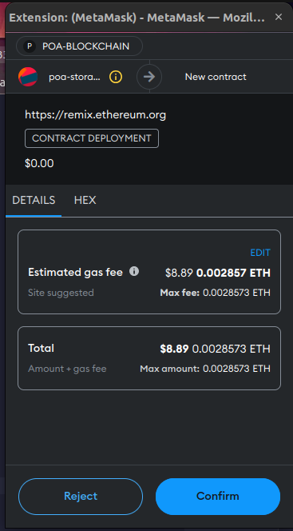
Process:
Account Management:
MetaMask is used to create and manage accounts, such as the Admin account (for deploying admin-specific smart contracts) and Bank accounts (for KYC operations).
Transaction Handling:
Contract Deployment: Admin deploys Admin.sol, and banks deploy Bank.sol.
Transaction Handling: Banks send KYC data transactions to the blockchain.
Secure Signing: MetaMask securely signs each transaction without exposing private keys.
Interaction with Smart Contracts:
Ether.js are used to interact with the Ethereum blockchain to call functions (like KYC registration) from the frontend. They handle sending transactions, reading the blockchain, and confirming successful operations.
This process ensures secure, transparent, and verifiable transactions while maintaining account privacy.

Slide 23


Monitor Nodes and Network Performance
This section explains how to monitor the performance of Ethereum nodes and the overall network in your KYC verification application.
Tools Used: Prometheus, Grafana
Prometheus: A monitoring system that collects metrics from your Ethereum nodes (e.g., Admin, Bank1, Bank2) such as CPU usage, memory usage, and transaction count.
Grafana: A visualization tool used to display the collected metrics in real-time through dashboards.

Slide 24
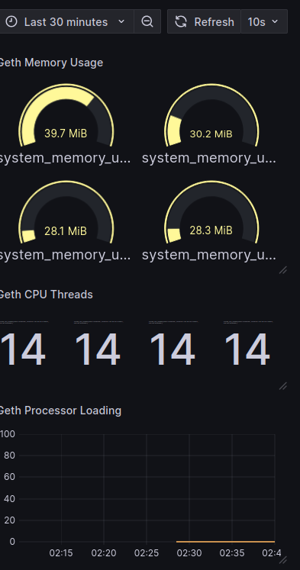
Process:
Metrics Collection:
Set up Prometheus to scrape metrics from your Ethereum nodes. These metrics include:
CPU Usage
Memory Usage
Transaction Count
Visualize Data:
Prometheus sends the collected data to Grafana, where it is displayed on customizable dashboards.
By monitoring the nodes and network performance, you can identify potential issues early and optimize the system for better scalability and reliability.

Slide 25

COORDINATE NODE DEPLOYMENT AND SCALING
the process of managing the deployment and scaling of Ethereum nodes in a network. This involves using tools like Minikube to deploy, configure, and scale blockchain nodes efficiently within a local Kubernetes environment.
Tool Used: Minikube
Minikube is a tool for running a Kubernetes cluster locally. It is ideal for testing and development environments and provides a lightweight, single-node Kubernetes setup to simulate a larger Kubernetes cluster.

Slide 26
What We Did with Minikube
We used Minikube for the following:
Setting Up Local Kubernetes Cluster
Deployment of Ethereum Nodes
Service Discovery & Networking
Resource Management
Testing & Local Development
Minikube provided an ideal local environment to simulate and deploy the Ethereum-based KYC verification network, offering the benefits of Kubernetes while being lightweight and cost-effective.

Slide 27
CONCLUSION
This blockchain-based KYC project uses MetaMask for account management, Geth with PoA for consensus, and Solidity to develop KYC smart contracts (Bank.sol and Admin.sol). Docker isolates Ethereum nodes, while Remix handles contract development and deployment. Ether.js enables frontend-blockchain interaction, and Prometheus with Grafana monitors node performance. Minikube manages the Ethereum network in a local Kubernetes environment, ensuring security, scalability, and efficiency.

Slide 28
FUTURE ENCHACEMENT
Scalability & Security: Expand the Ethereum network, integrate multi-signature wallets or hardware security modules, and connect with government databases for streamlined KYC.
Monitoring & Interoperability: Implement advanced monitoring with the ELK Stack, cross-chain interoperability, and automated regulatory reporting.
Smart Contract Enhancements: Improve smart contracts with role-based access control, transaction fee management, and introduce user incentives for verified entities.

Slide 29
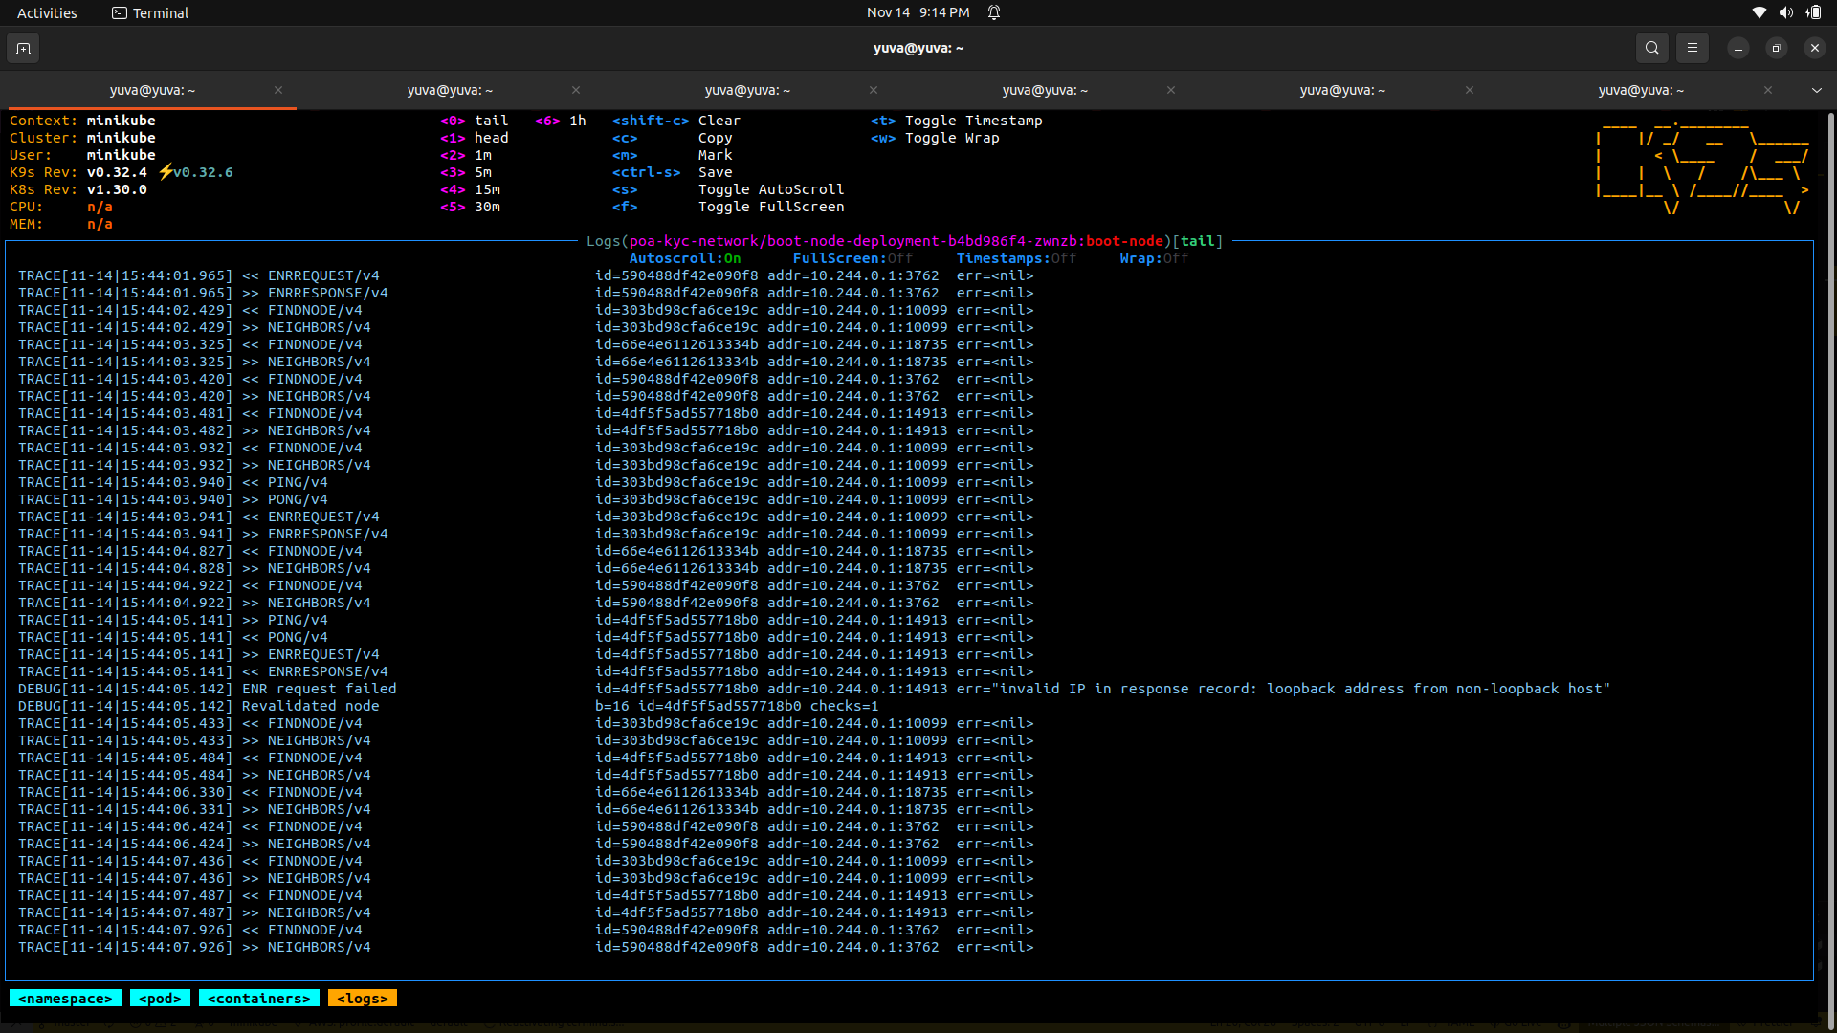
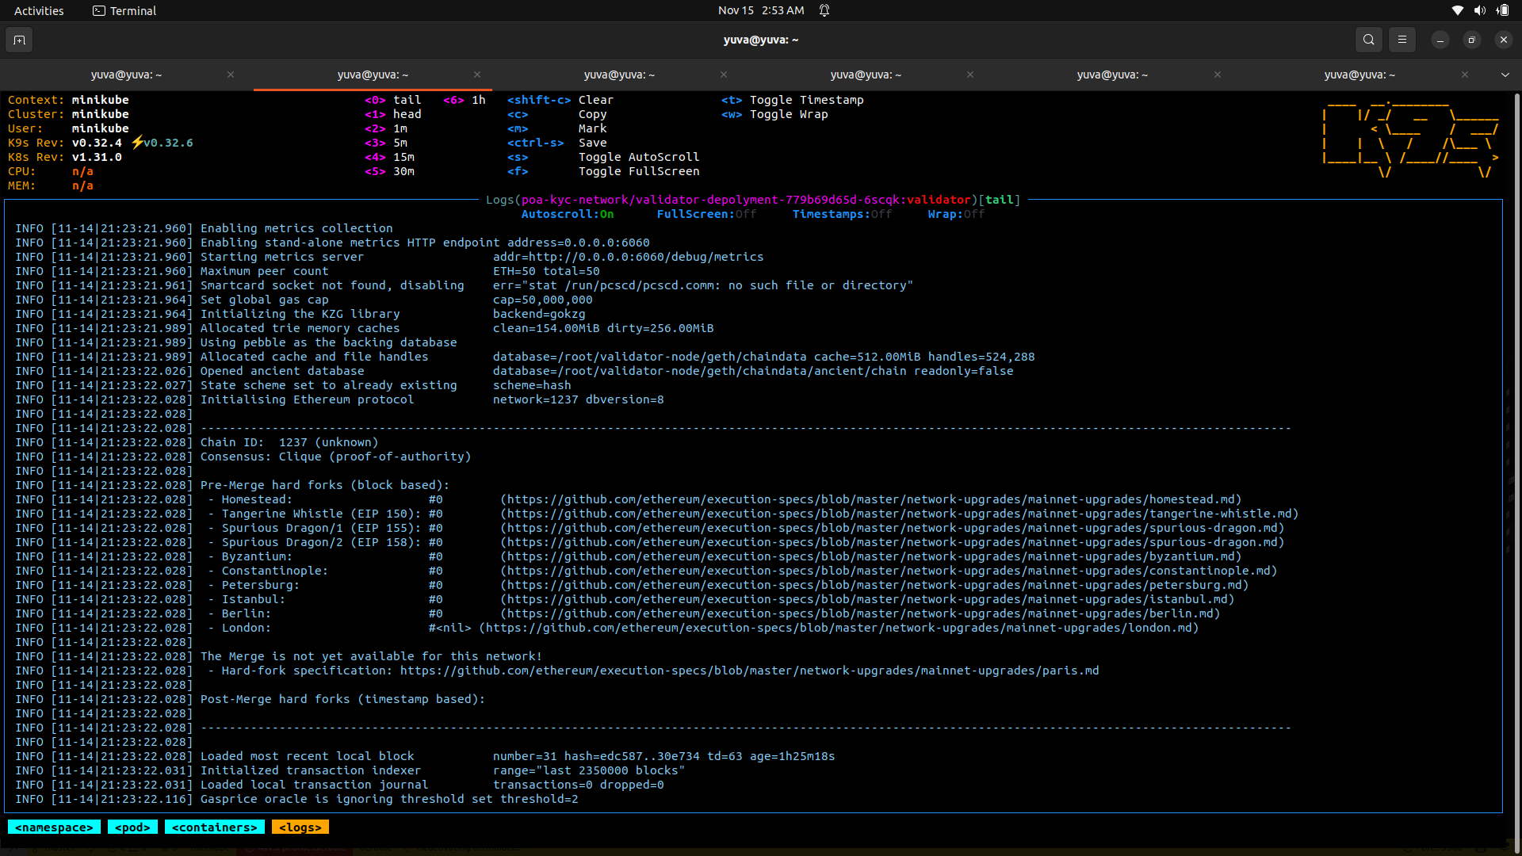
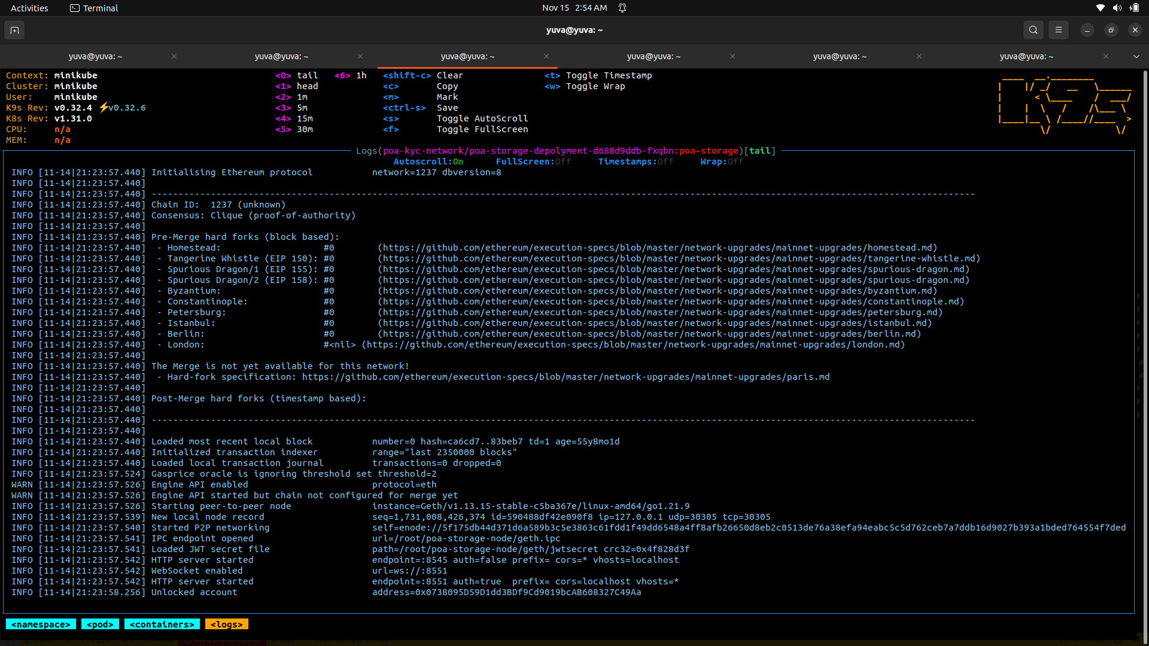
OUTPUT
BOOT NODE
VALIDATOR NODE
POA STORAGE NODE

Slide 30
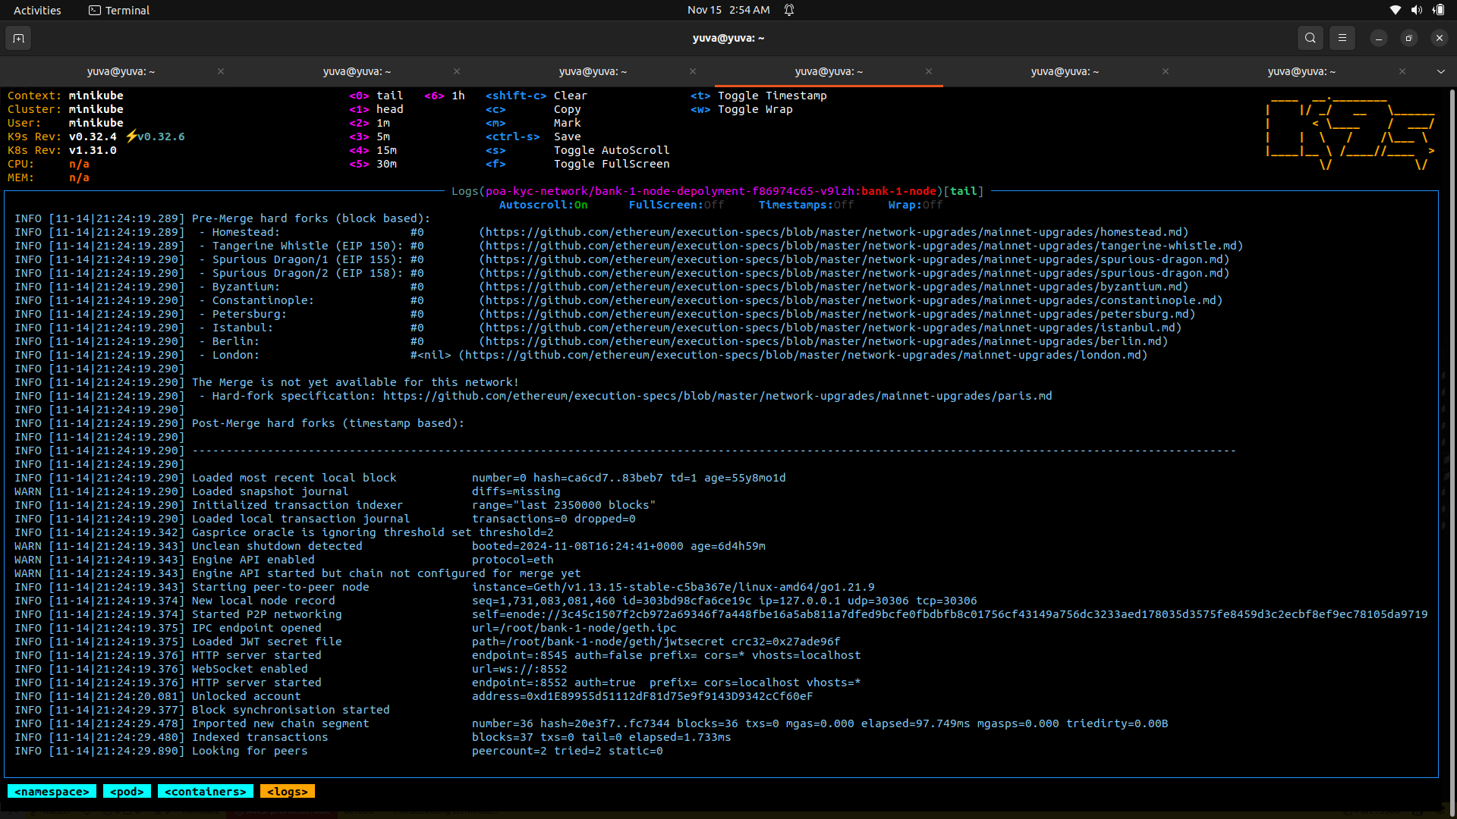
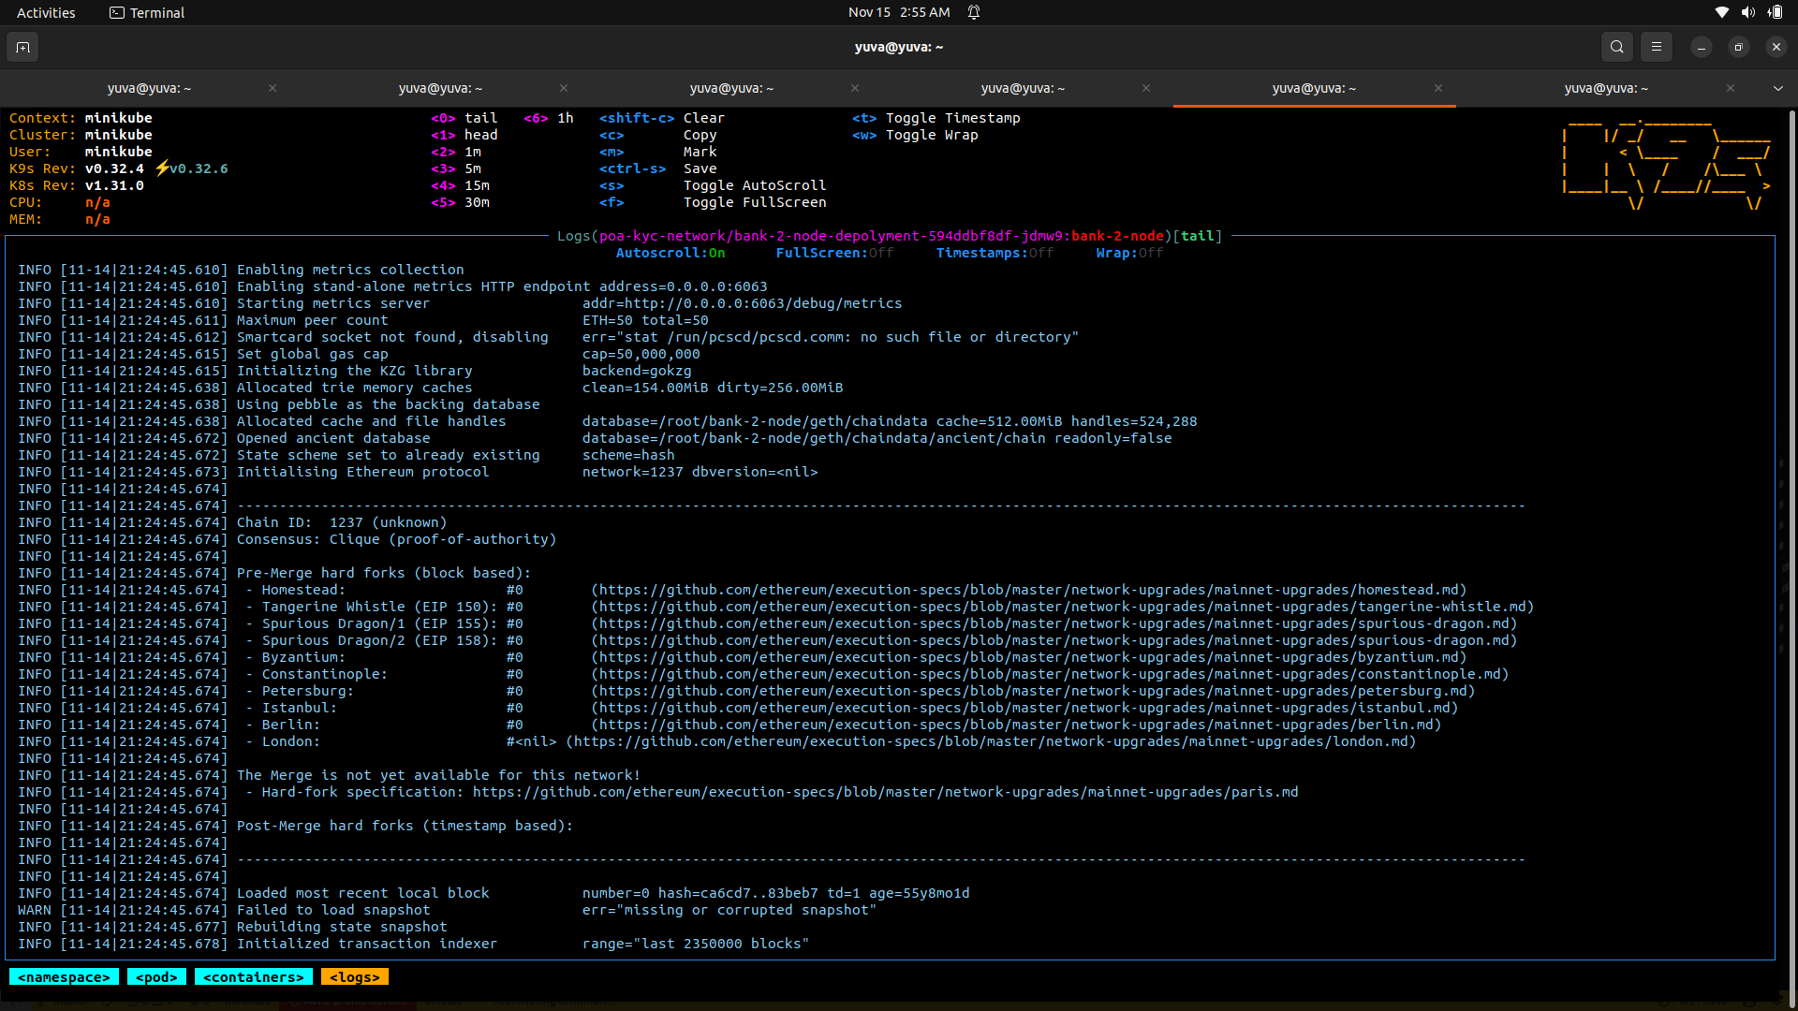
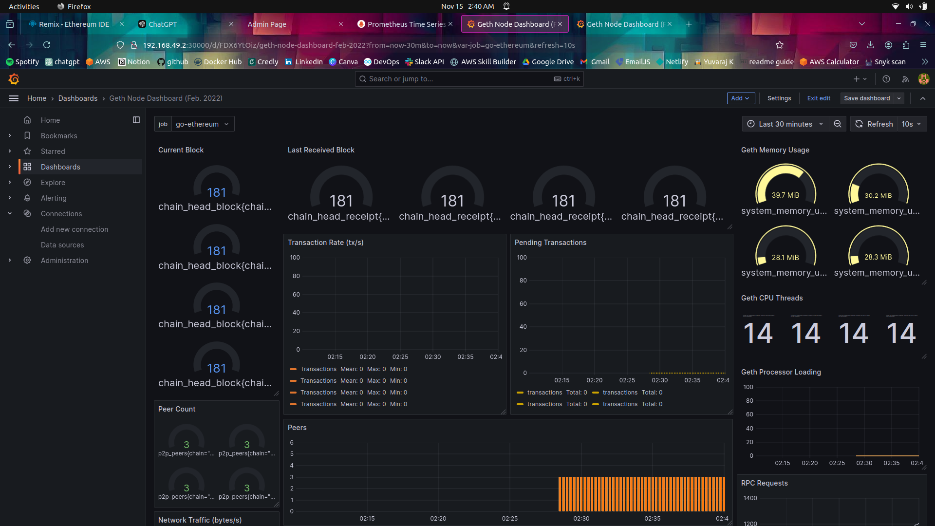
BANK 1 NODE
BANK 2 NODE
GRAFANA DASHBOARD

Slide 31
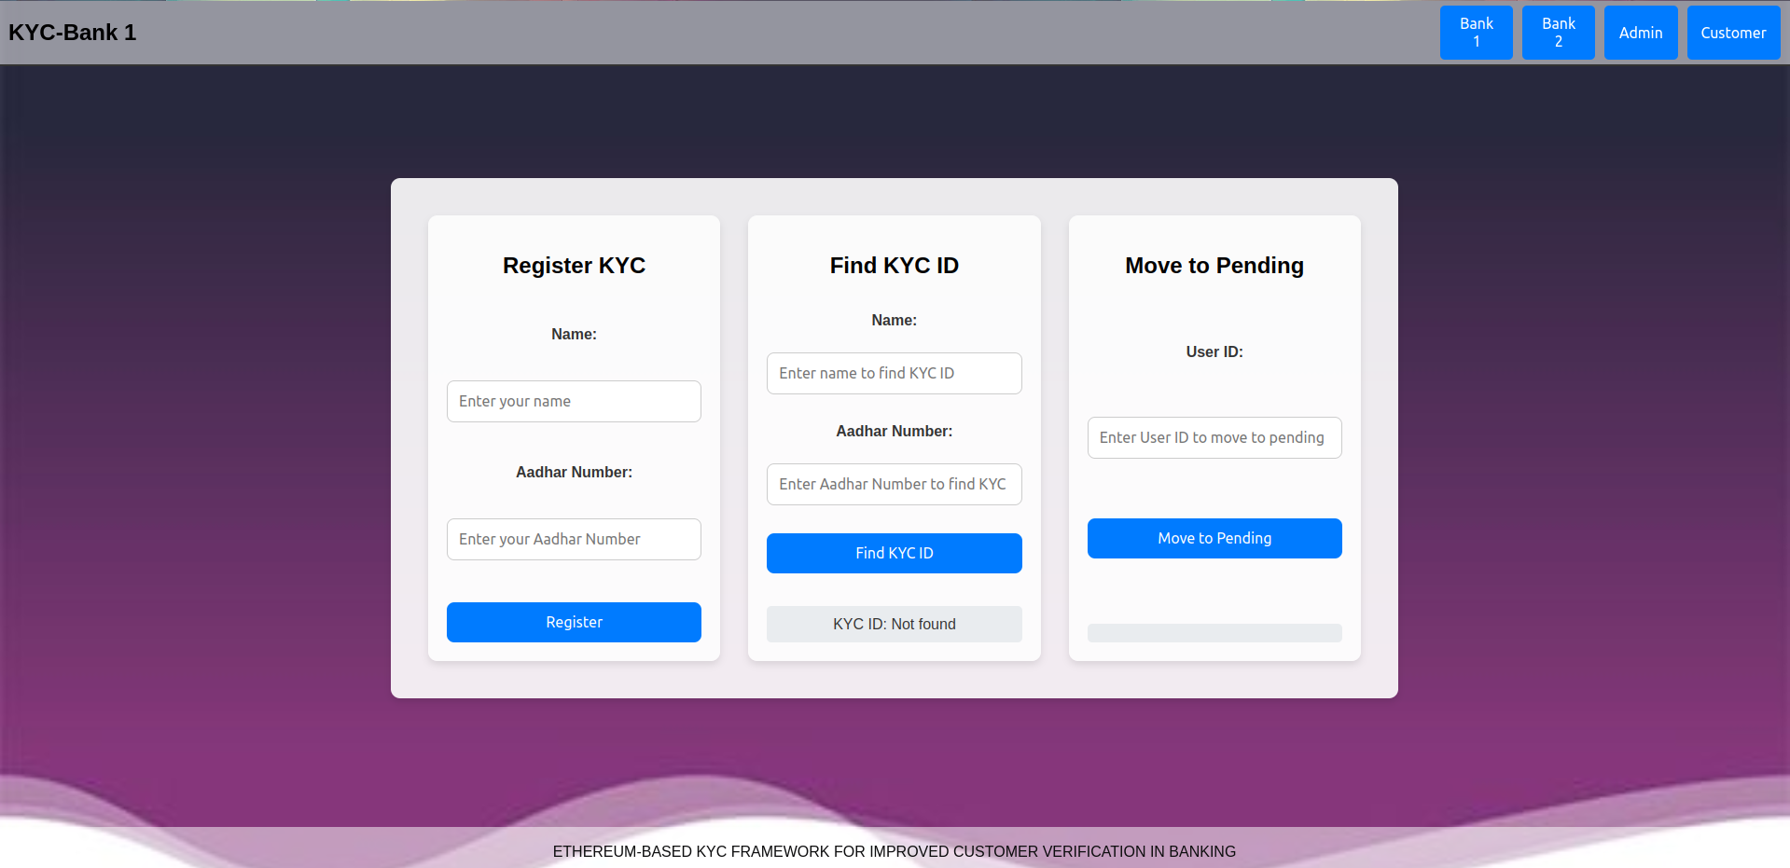
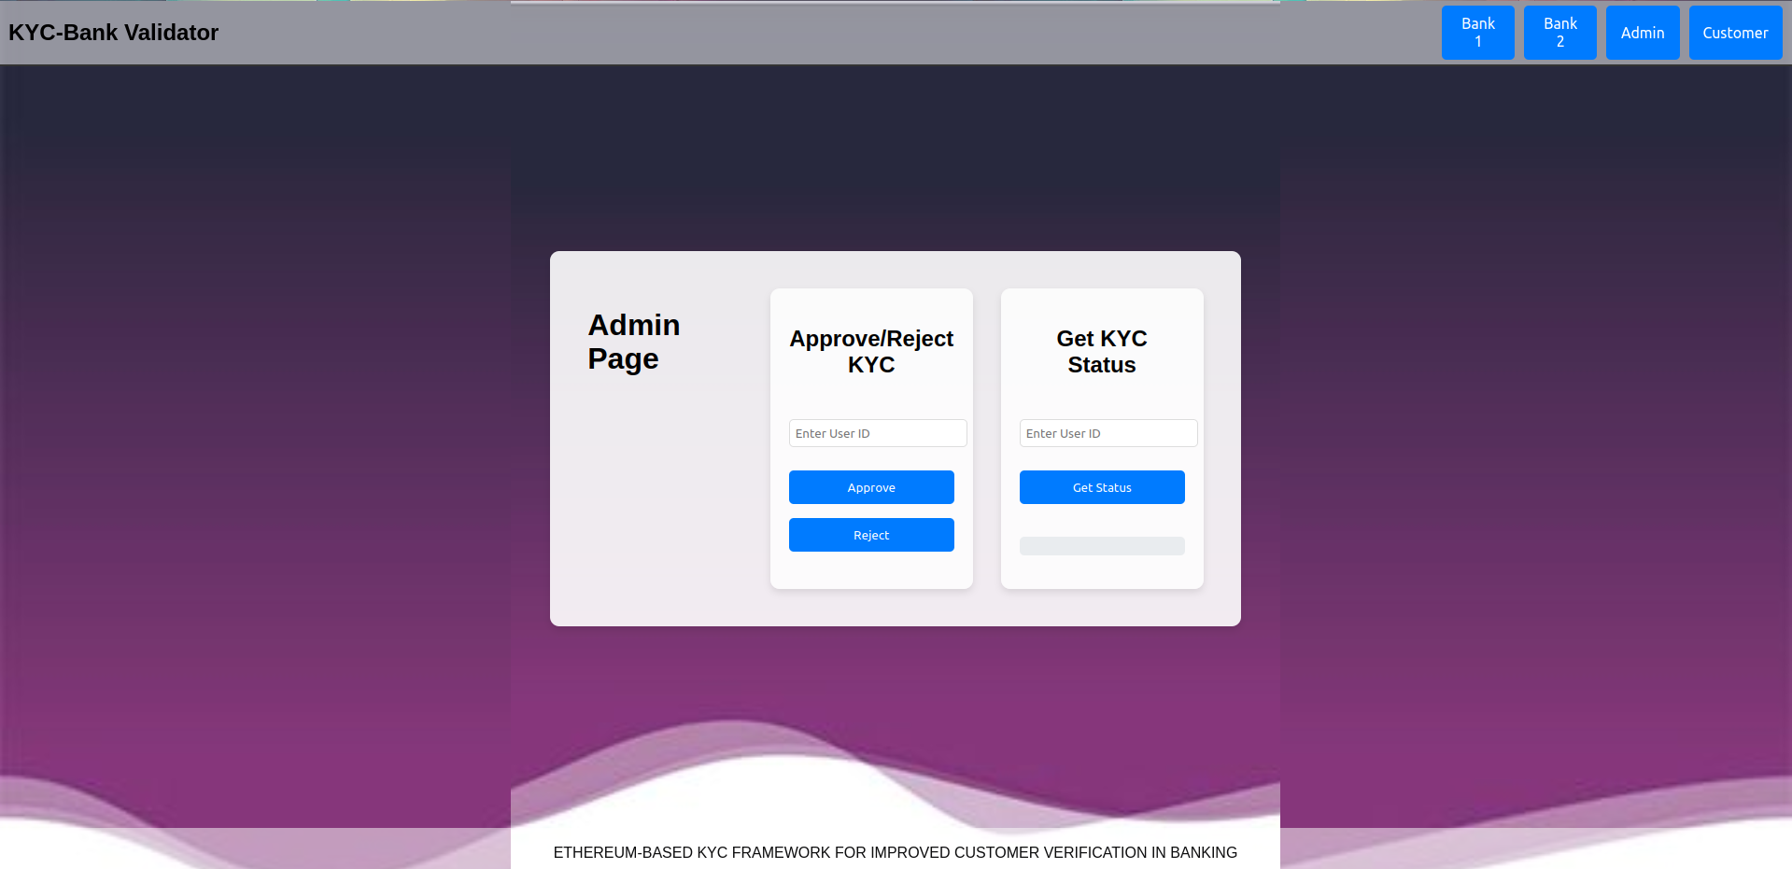
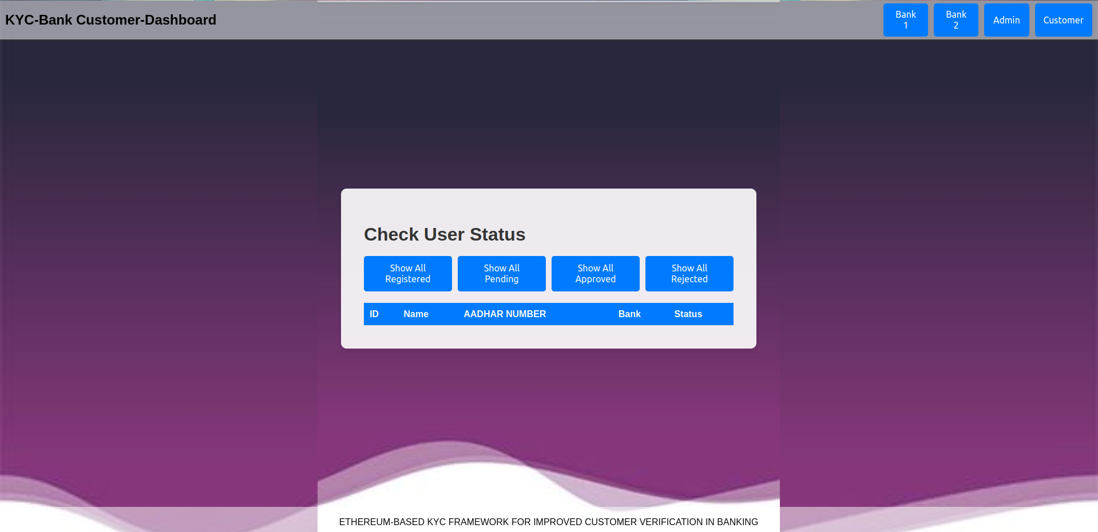
BANK PAGE
ADMIN PAGE
CUSTOMER PAGE

Slide 32
REFERENCE
M. N. M. Bhutta, A. A. Khwaja, A. Nadeem, H. F. Ahmad, M. K. Khan, M.A.Hanif, H.Song,M.Alshamari,andY.Cao,‘‘Asurveyonblockchain technology: Evolution, architecture and security,’’ IEEE Access, vol. 9, pp. 61048–61073, 2021.
J. Gomes, S. Khan, and D. Svetinovic, ‘‘Fortifying the blockchain: A systematic review and classification of post-quantum consensus solutions for enhanced security and resilience,’’ IEEE Access, vol. 11, pp. 74088–74100, 2023.
V. Kumar C and P. Selvaprabhu, ‘‘An examination of distributed and decentralized systems for trustworthy control of supply chains,’’ IEEE Access, vol. 11, pp. 137025–137052, 2023.
R. Norvill, M. Steichen, W. M. Shbair, and R. State, ‘‘Demo: Blockchain for the simplification and automation of KYC result sharing,’’ in Proc. IEEE Int. Conf. Blockchain Cryptocurrency (ICBC), May 2019, pp. 9–10.
B. Karadag, A. Halim Zaim, and A. Akbulut, ‘‘Blockchain-based KYC model for credit allocation in banking,’’ IEEE Access, vol. 12, pp. 80176–80182, 2024.
N. Mansoor, K. F. Antora, P. Deb, T. A. Arman, A. A. Manaf, and M. Zareei, ‘‘A review of blockchain approaches for KYC,’’ IEEE Access, vol. 11, pp. 121013–121042, 2023.
D. George, A. Wani, and A. Bhatia, ‘‘A blockchain based solution to know your customer (KYC) dilemma,’’ in Proc. IEEE Int. Conf. Adv. Netw. Telecommun. Syst. (ANTS), Dec. 2019, pp. 1–6.
R. Patel, M. Migliavacca, and M. E. Oriani, ‘‘Blockchain in banking and f inance: Abibliometric review,’’ Res. Int. Bus. Finance, vol. 62, Dec. 2022, Art. no. 101718.

Slide 33
THANK YOU

